Slide 1
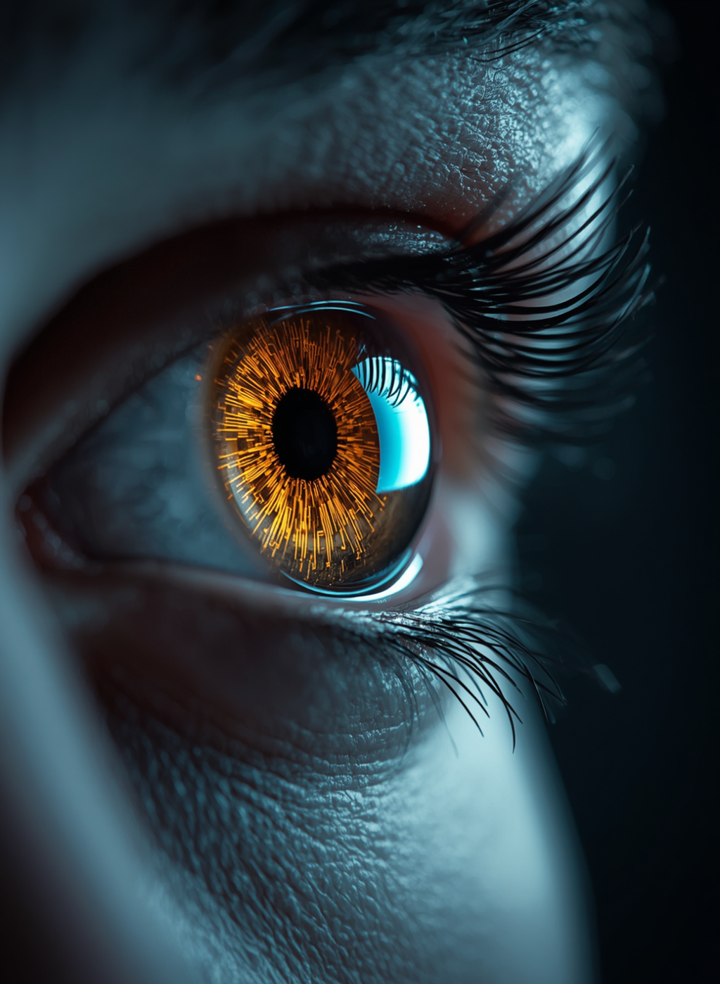
1
Event-Based Cameras: Inspired by human eye
How the human eye revolutionized camera technology — capturing light the way biology sees the world.
PRESENTED BY :
NEEL PATIL-C351
VIRANSH NISHAR -C335
AKSHAT PANDEY-C339
ATHARV PATIDAR-C348

Slide 2
2
FLOW OF CONTENTS
  PROBLEM STATEMENT
  2. BIOLOGICAL PHENOMENON
  3. APPLICATIONS
  4. PROS & CONS
  5. RESEARCH TIMELINE
  6. STATISTICAL DATA
  7.FUTURE PROSPECTS
  8. CONCLUSION

Slide 3
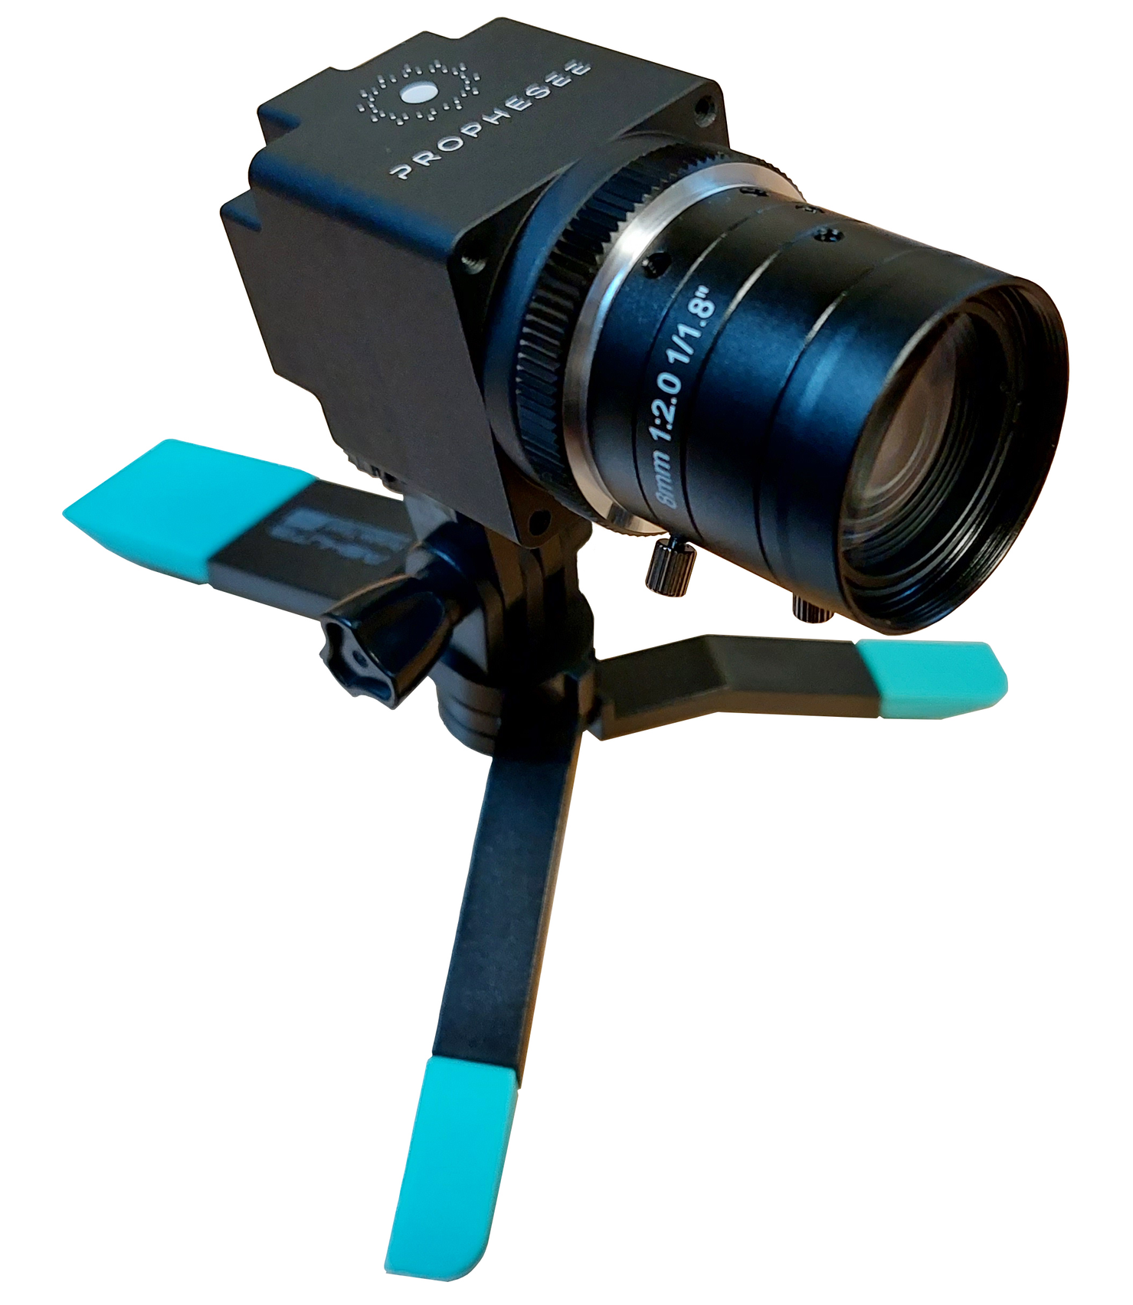
3
PROBLEM STATEMENT
Poor Performance: "Motion blur at high speed; struggles in low-light/high-contrast scenes."
Redundant Data: "Traditional cameras capture full frames at a fixed rate, even when nothing changes."
Retina's Edge: "The retina only signals change — no redundant data, no wasted power."
Research Gap: "Event cameras don't yet use spatial context or the ~20 specialized cell types the retina has.

Slide 4
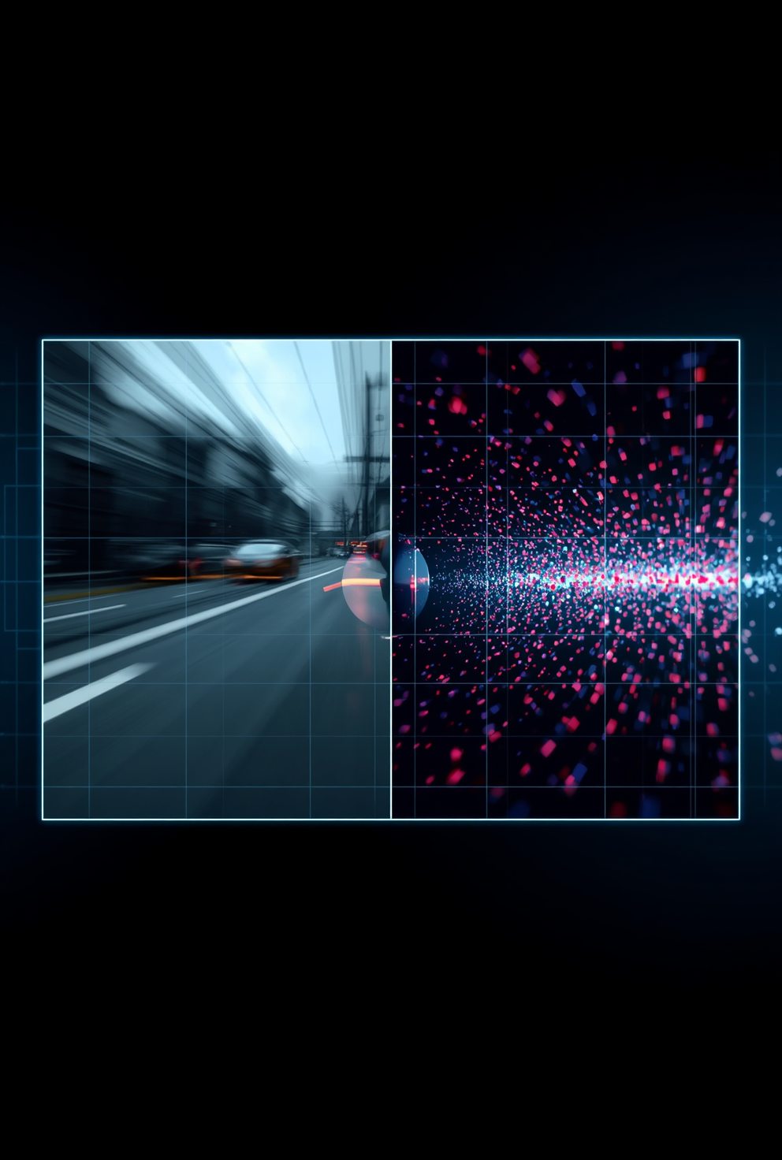
4
BIOLOGICAL PHENOMENON
  Core Idea: Retina detects change in light, not absolute brightness.
  Phototransduction: Rods & cones convert photons into electrical signals.
  ON/OFF Split: ON cells fire when light increases; OFF cells fire when light decreases.
  Early Edge Detection: Contrast & edges are detected before signals even reach the brain.

Slide 5
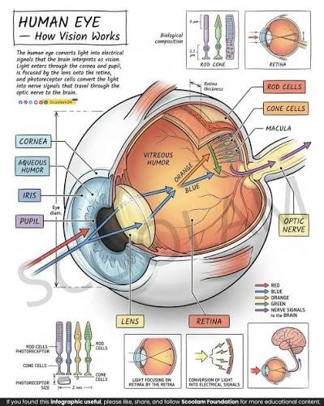
5
HOW RETINA WORKS
  Photoreceptors absorb light to graded voltage signal.
  Horizontal cells sharpen contrast via lateral feedback.
  Bipolar cells split signal into ON/OFF pathways.
  Amacrine cells add temporal processing.
  RGCs convert signal into spikes through optic nerve.
  Retina adapts sensitivity over time .

Slide 6
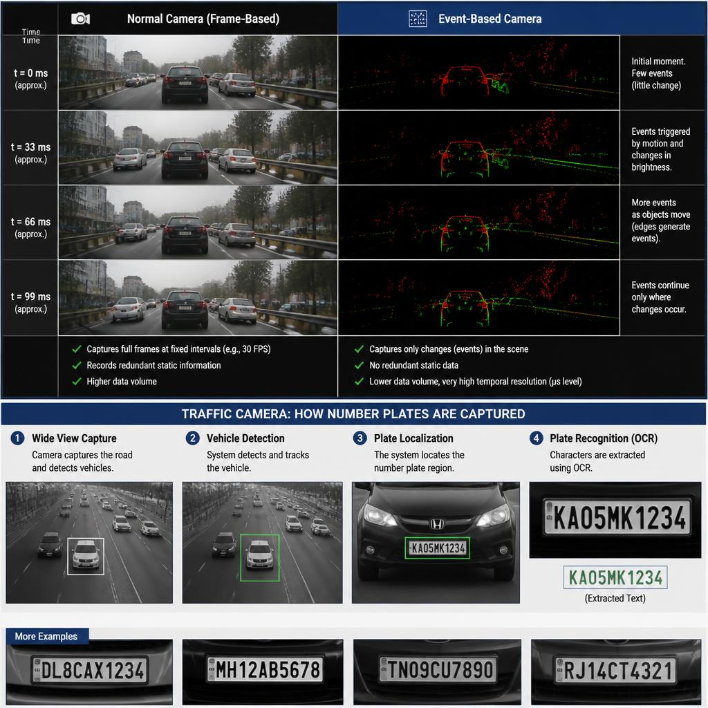
6

Slide 7
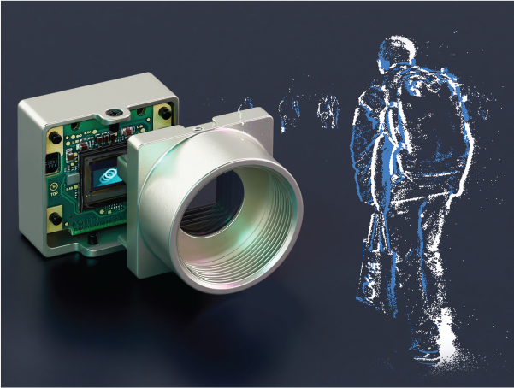
7
WORKING OF EVENT BASED CAMERA
  Photoreceptor Stage: Photodiode converts light to current; logarithmic response = huge dynamic range .
  Change Stage: Circuit compares current signal to last recorded value.
  Comparator Stage: Fires ON/OFF event if change crosses a threshold.
  Output: Each event = (x, y, timestamp, polarity) — asynchronous & sparse.

Slide 8
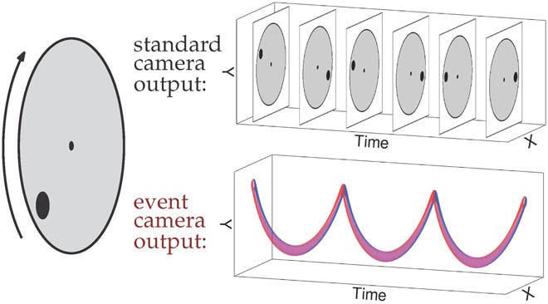
8

Slide 9
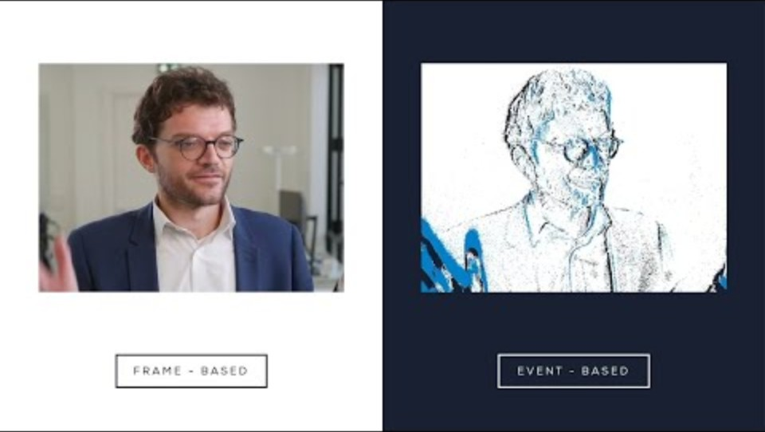
9

Slide 10
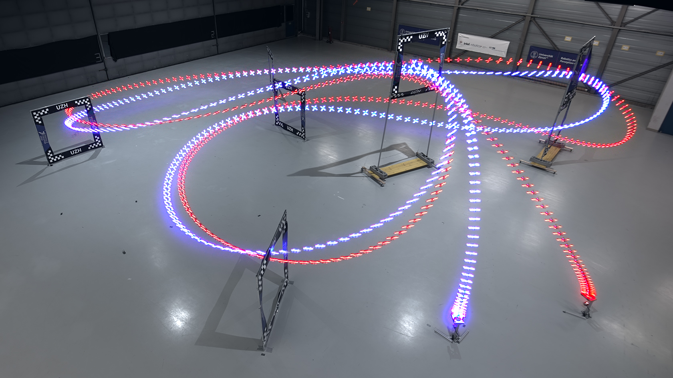
12
APPLICATIONS
1.High-Speed Robotics & Drone Control
  Vision-Based State Estimation for Fast Flight
  Deep Learning for Obstacle Avoidance (Learning High-Speed Flight in the Wild)
  Trajectory Planning Through Narrow Spaces
  Perception-Aware Model Predictive Control (PAMPC)
  Sim-to-Real Transfer for Agile Flight

Slide 11
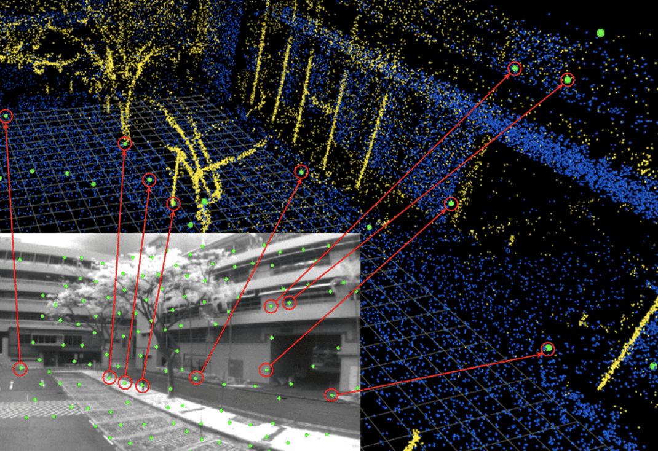
11
  2.Visual SLAM & Navigation
  ORB-SLAM (Camera-Based Mapping)
  Feature Matching Between Frames
  Loop Closure (Recognizing Revisited Places)
  Combining Camera + Motion Sensors (IMU)
  Removing Moving Objects from the Map

Slide 12
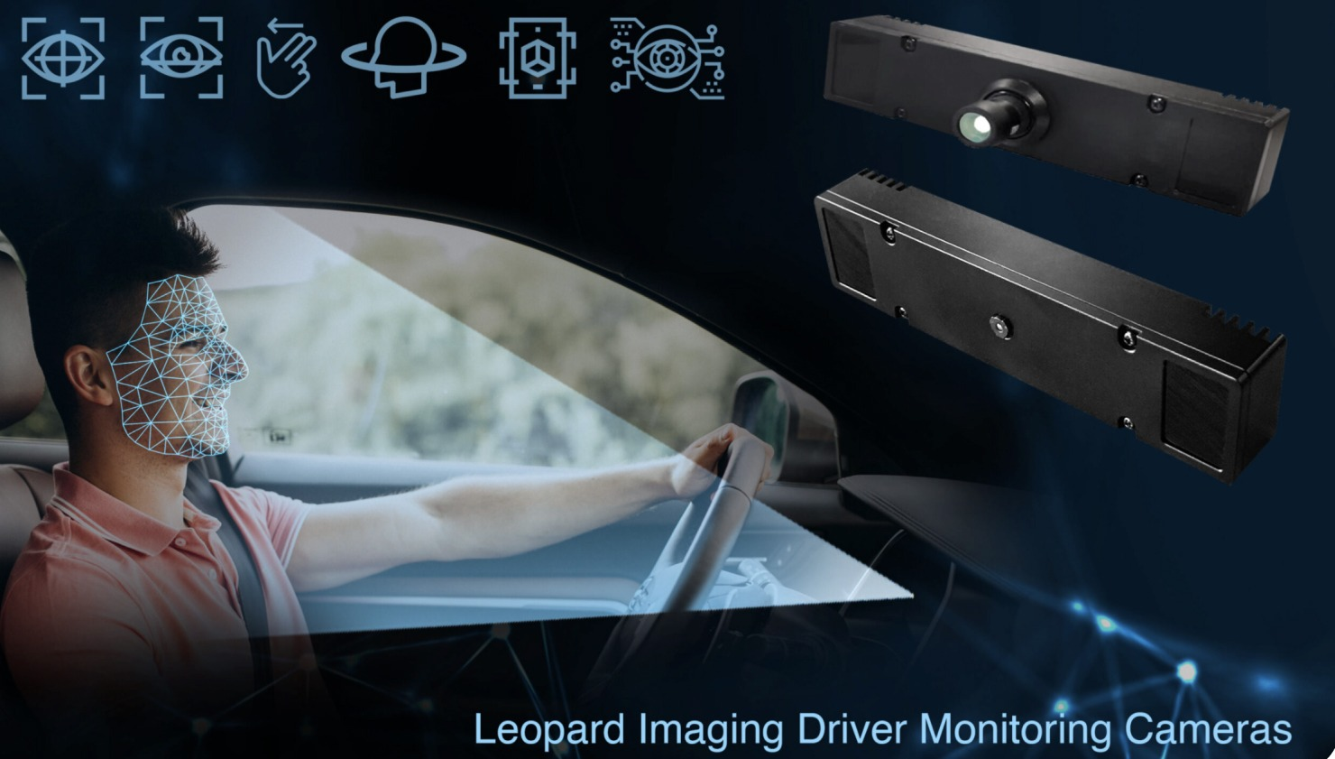
11
  3.Driver Monitoring — Face/Eye/Blink Tracking
  Facial Landmark Detection – commonly done with Dlib or MediaPipe-based models to locate eyes, eyebrows, and mouth points
  Eye Aspect Ratio (EAR) a widely-cited method for detecting blinks from landmark geometry
  CNN-Based Drowsiness Classification – papers train CNNs directly on eye-region images to classify open/closed or drowsy/alert states

Slide 13
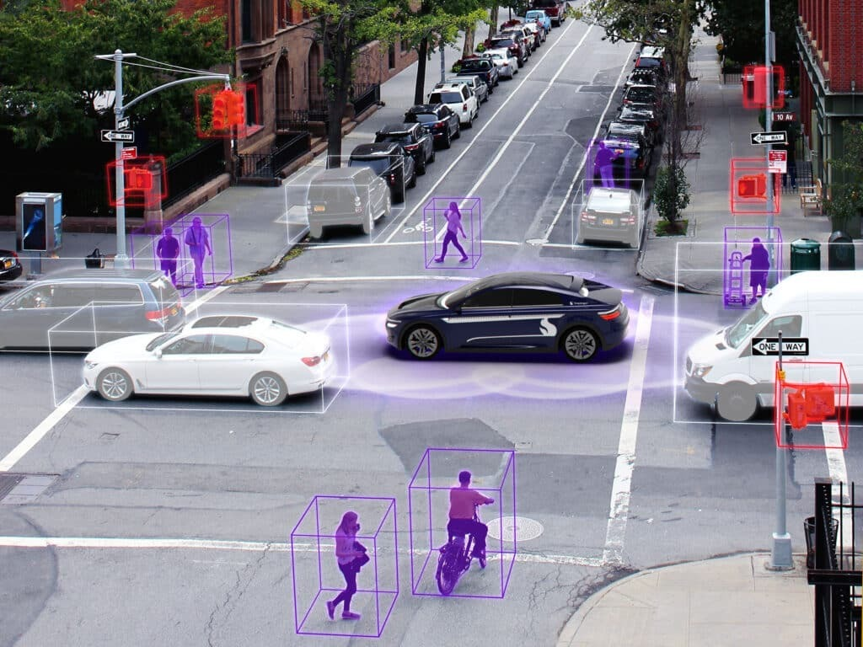
13
4. Autonomous Driving — Pedestrian Detection
  Deep CNN Detectors – Faster R-CNN, YOLO, and SSD models widely used for real-time pedestrian localization in road scenes
  Multi-Sensor Fusion – Combining camera + LiDAR + radar data improves detection accuracy in low-light/occlusion conditions
  Speed-Accuracy Trade-off – Papers optimize lightweight models (Mobile Net-based) for real-time inference on embedded/edge devices in vehicles

Slide 14
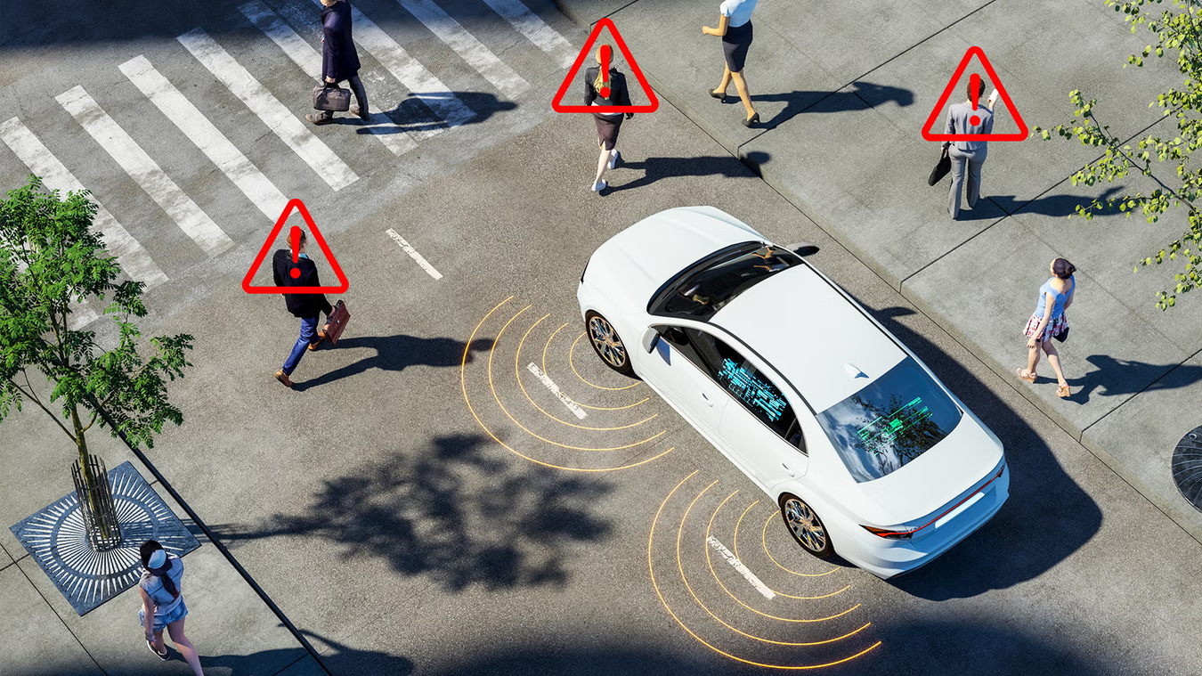
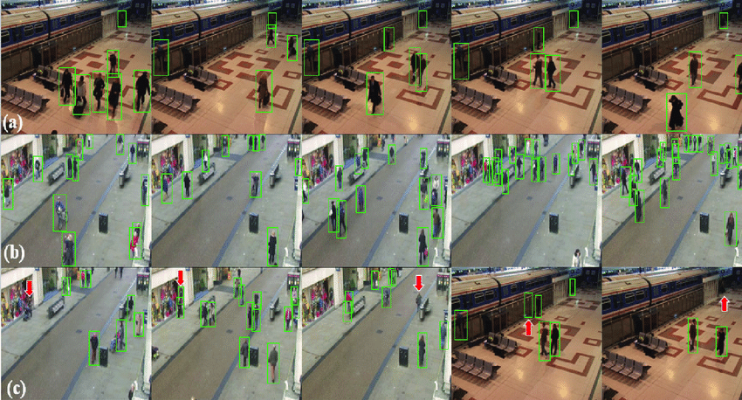
14

Slide 15
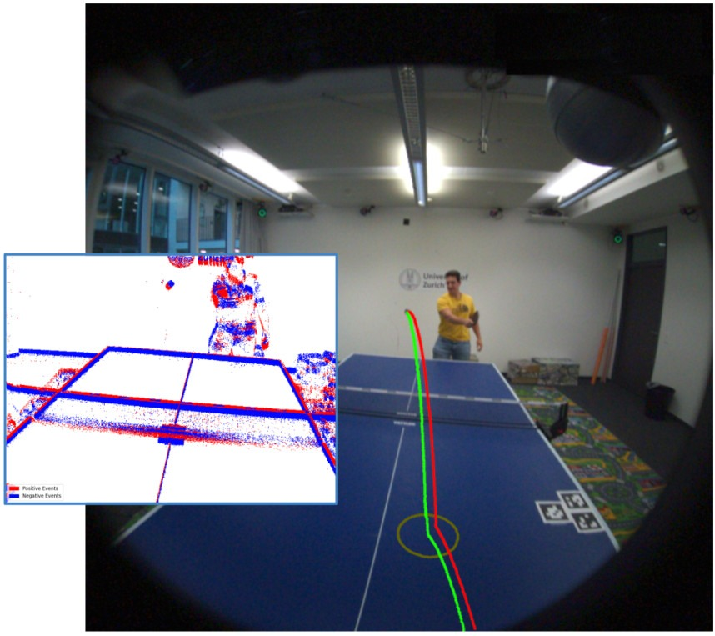
15
5. Object Detection & Recognition
  Autonomous Driving – Detects pedestrians, vehicles, traffic signs for real-time driving decisions (YOLO, Faster R-CNN)
  Medical Imaging – Identifies tumors/lesions in CT, MRI, X-rays for early disease diagnosis
  Video Surveillance – Enables intrusion detection, crowd monitoring, and suspicious activity tracking

Slide 16
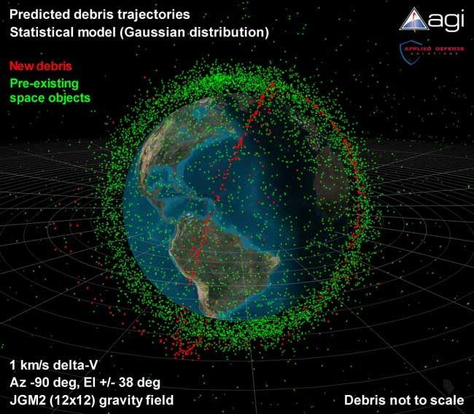
16
6.Space Situational Awareness
  Telescope-mounted event sensors tested for tracking satellites/debris
  Detected objects from LEO to GEO orbits
  Worked in both daytime and night-time — very hard for conventional CCDs
  Low data rate, low power, and high speed suit space-based hardware constraints

Slide 17
17
PROS & CONS
PROS
CONS
  Ultra-low latency — microsecond response
  Extremely high dynamic range — up to 120–143 dB
  Low power & low bandwidth — only changed pixels emit data
  No motion blur — asynchronous per-pixel operation
  Ideal for high-speed tracking — drones, particles, robotics
  No absolute intensity/color in pure DVS mode
  Added intensity readout doubles pixel size & raises latency (ATIS)
  Data format hard to compress — doesn't fit standard video codecs
  Immature software ecosystem — needs new algorithms, not legacy CV
  Expensive & niche
  Prone to noise — especially in low-contrast/flickering scenes

Slide 18
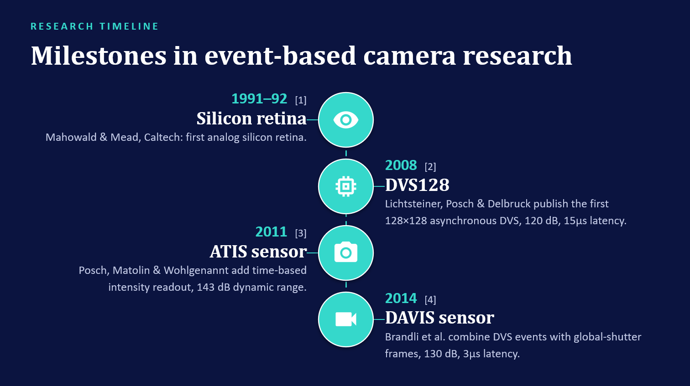
18

Slide 19
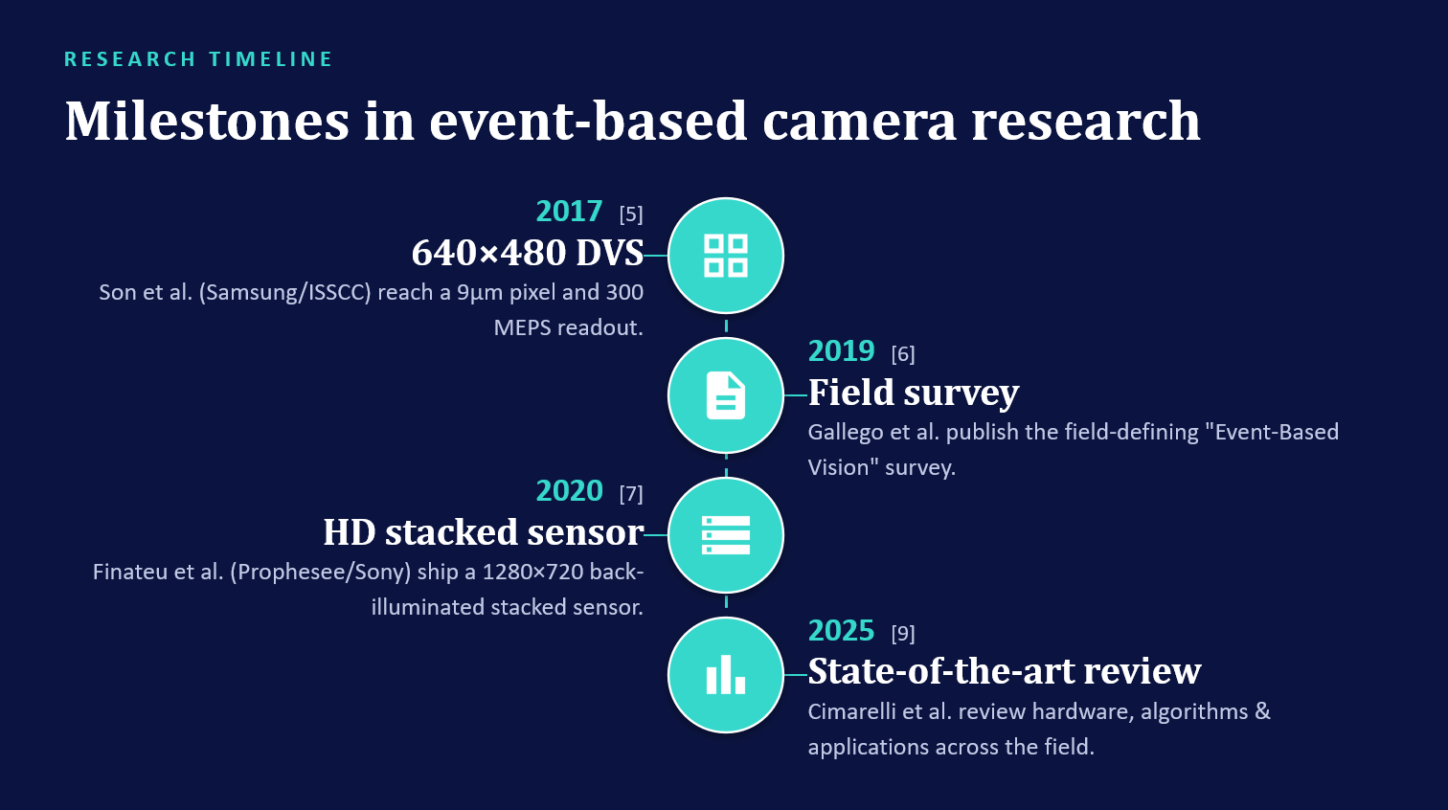
19

Slide 20
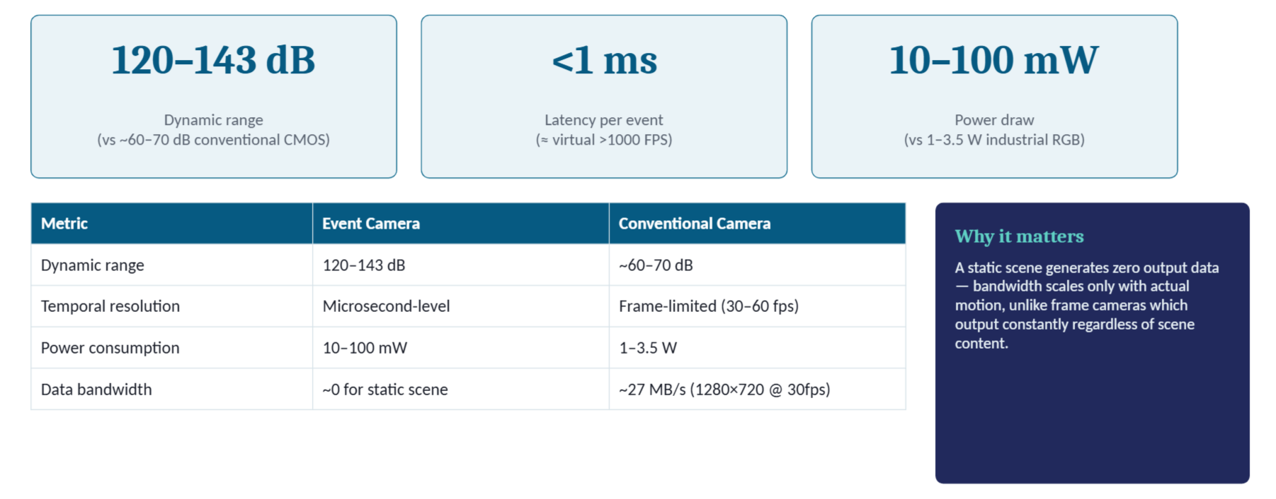
20
STATISTICAL DATA

Slide 21
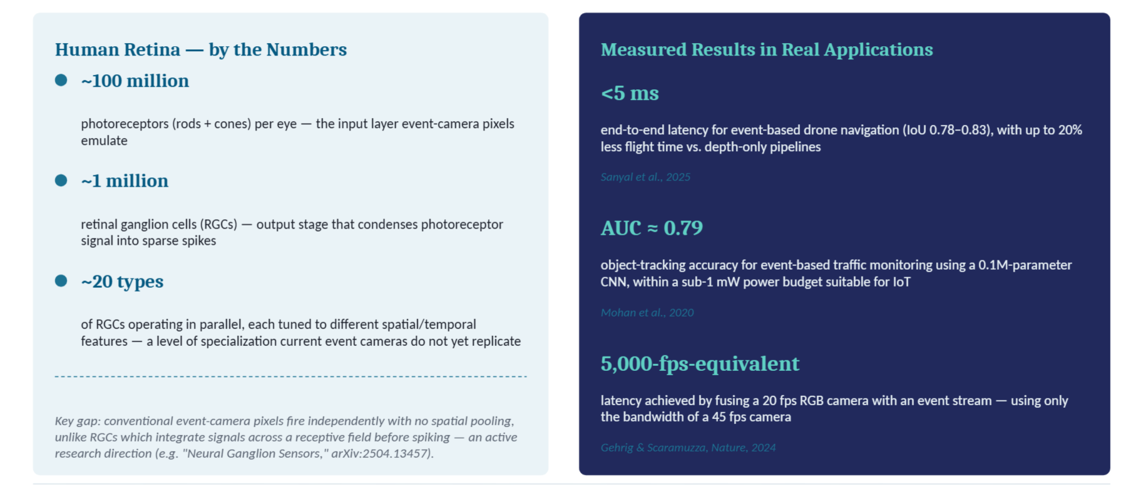
21
STATISTICAL DATA

Slide 22
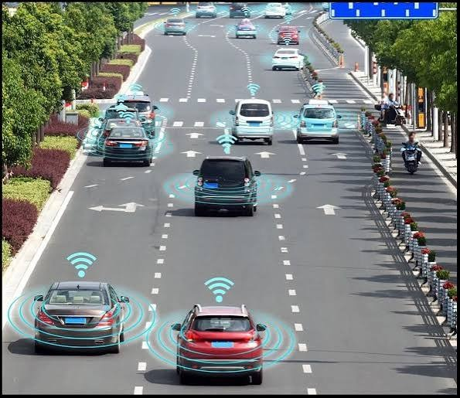
22
FUTURE PROSPECTS
Autonomous Vehicles
  High temporal resolution and low latency which detects fast-moving objects & sudden traffic changes
  Handles extreme lighting shifts
  Event based cameras complement conventional cameras through providing precise motion information
  Fusion improves perception reliability in high-speed, adverse conditions

Slide 23
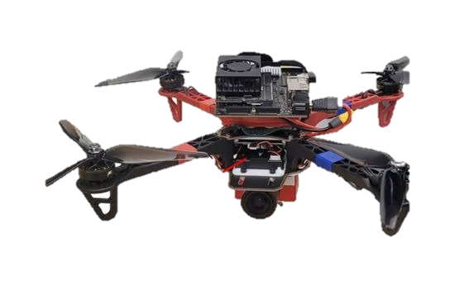
23
FUTURE PROSPECTS
UAVs (Drones)
  Enables indoor navigation where GNSS is unreliable
  High temporal resolution and motion-blur resistance suits rapid drone maneuvers
  Works well in challenging lighting
  Paired with IMU and Visual-Inertial Odometry (VIO) gives real-time position/orientation estimation
  Lightweight, low-power makes it ideal for navigation, surveillance, inspection

Slide 24
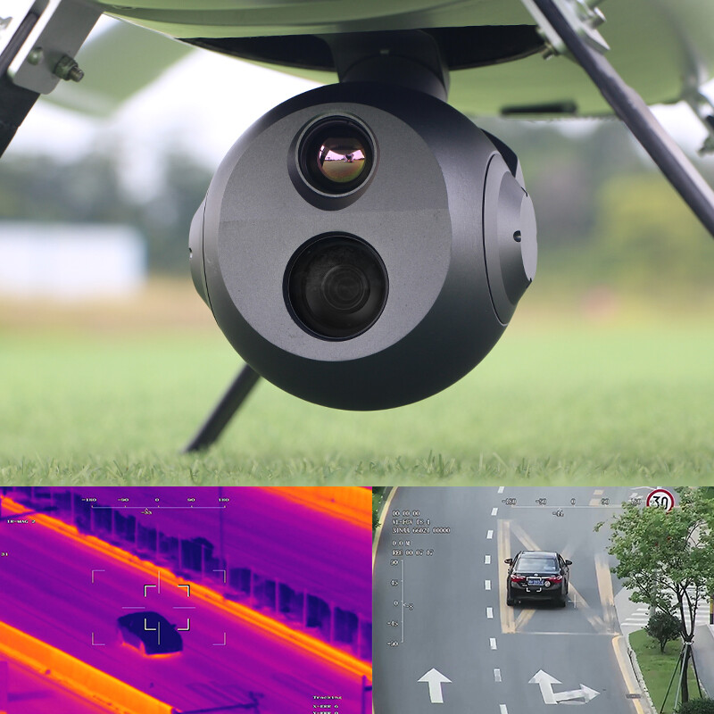
24
FUTURE PROSPECTS
  Smart Surveillance
  Low latency + high temporal resolution → detects rapid movements, accidents, suspicious activity
  Reliable in poor/variable lighting
  Combined with AI/computer vision → real-time monitoring, faster threat detection
  Suited for public spaces, transport hubs, hospitals, smart cities

Slide 25
25
CITATIONS
  https://arxiv.org/html/2504.13457
  https://arxiv.org/html/2408.13627v2
  https://ijsrem.com/uploads/production/1763788105wpdm_Smart-Surveillance-System.pdf
  https://arxiv.org/html/2504.08588v1
  https://arxiv.org/html/2408.13627v2

Slide 26
CONCLUSION
26
Biology-inspired, proven, complementary. By mimicking the retina's change-detection principle, event cameras sense only what moves — cutting redundant data and matching the eye's efficiency. This pays off across domains: faster on-chip control for drones, notable accuracy gains in SLAM, and more robust detection in poor lighting than frame-based systems achieve.
But event cameras aren't a replacement — they're complementary. Event data excels at motion and timing precision; frame data still wins on spatial and colour detail. And the retina itself remains far ahead: its 20 specialized cell types and rich spatial processing dwarf what current sensors replicate, which is really just the core change-detection idea. The surrounding ecosystem — algorithms, compression, cost — hasn't caught up to the hardware yet.
As event-frame-IMU fusion matures, event-based vision looks set to become standard wherever latency, speed, or extreme lighting matter most: autonomous vehicles, UAVs, surveillance.

Slide 27
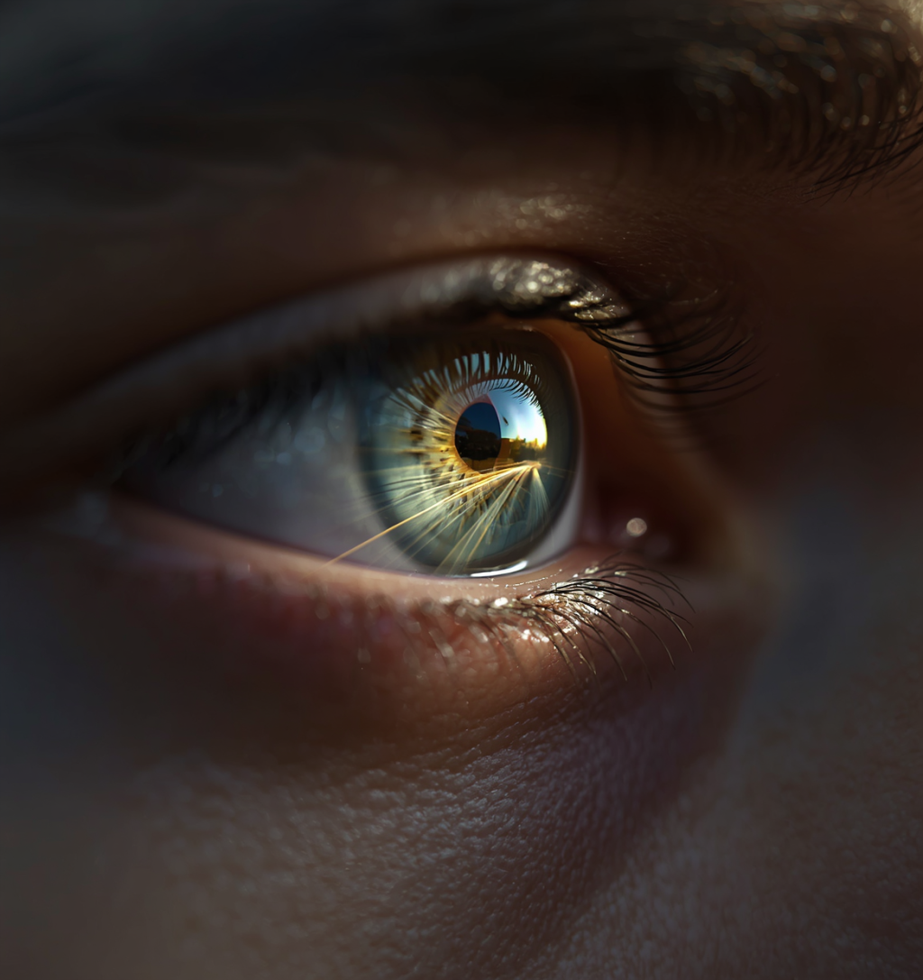
27
Thank You!!

